Slide 1
18. Balanced Trees, Part 2
ECE 309
Dr. James Tuck

Slide 2
Objectives
Briefly review the principles of left rotation and right rotation.
Describe the four patterns for balancing a tree: (2,1), (2,-1), (-2,-1), and (-2,1).
Describe the approach for balancing a tree on insertion and removal.
Implement an AVLTree using public inheritance from a BinarySearchTree.

Slide 3
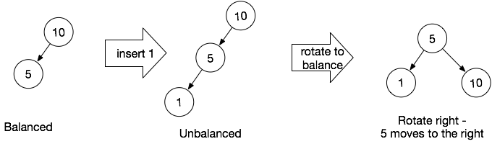
How do we keep a BST balanced?
If we insert into an unbalanced sub-tree, we rotate it.
A rotation is a local re-arrangement of nodes in the BST to achieve an acceptable balance factor.

Slide 4
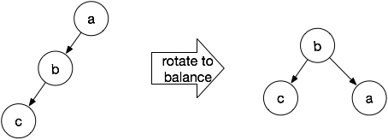
Right rotation
A right rotation moves nodes to the right. b moves up and replaces a, and a becomes the child of b.
In this case, b has no right child, so a can simply be reconnected there.

Slide 5
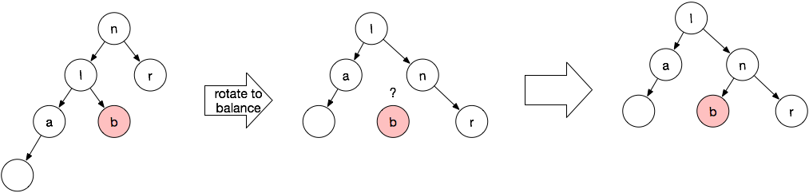
Right rotation
A right rotation on node n makes n the right child of n’s left child.
b is disconnected from l, but it can be reconnected as the left child of n, since it’s bigger than l and less than n.

Slide 6
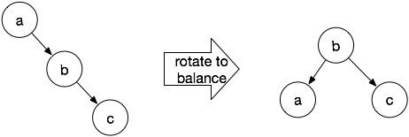
Left rotation
A left rotation moves nodes to the left. a becomes the left child of b, b takes a’s place.
In this case, b has no left child, so a can simply be reconnected there.

Slide 7
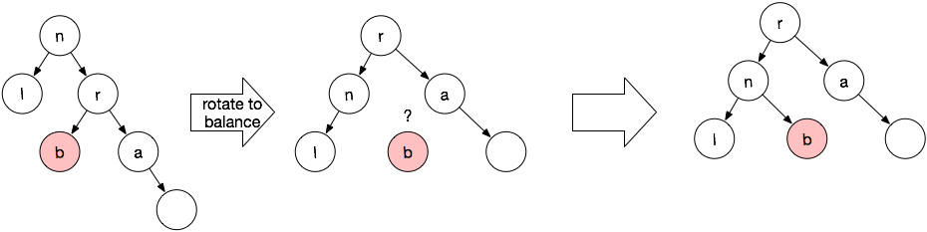
Left rotation
A left rotation on node n makes n the left child of n’s right child.
b is disconnected from r, but it can be reconnected as the right child of n, since it’s smaller than r and bigger than n.

Slide 8
When to rotate? (naive approach)
// after inserting (or removing) a node n
parent = parent of n
if the balance_factor(parent) == 2,
then more on left side so rotate right
if the balance_factor(parent) == -2,
then more on right side so rotate left

Slide 9
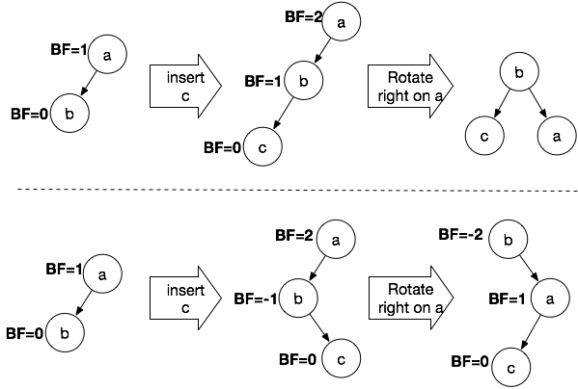
Doesn’t quite work out as planned
We get the effect we want, the tree is now balanced.
Whoops. We do not get what we want here; the root node remains imbalanced.
A single rotate right doesn’t work!

Slide 10
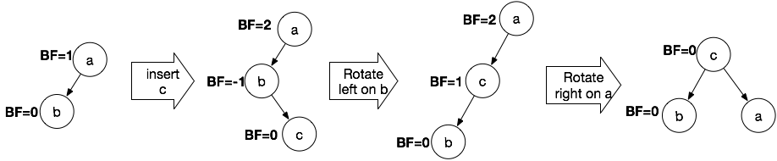
Works better if you rotate left first!
Rotating left on node b converts the tree into the shape we need for the right-rotate to work best!
Now we can balance the tree!

Slide 11
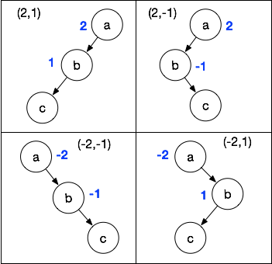
How do we distinguish these cases?
The balance factors allow us to tell them apart.
These patterns are often referred to by their balance factors: (2,1) and (2,-1)
First number is sub-tree root, second number is the child
2 means the left side has more height
There are analogous patterns going the opposite way: (-2,-1) and (-2, 1)
-2 means the right side has more height

Slide 12
Balance Tree Pseudocode
void balance(node) {
if ( balance_factor(node) == 2 ) {
if( balance_factor(node->left) == -1 ) rotate_left(node->left);
rotate_right(node);
} else if ( balance_factor(node) == -2 ) {
if ( balance_factor(node->right) == 1 ) rotate_right(node->right);
rotate_left(node);
}
}

Slide 13
Balance upon Insertion and Removal
When we insert or remove an item from the AVL tree, we will ensure that the tree is balanced.
For insertion, use BST insertion, then balance the new node’s parent and all of its ancestors.
For removal, use BST removal, balance depending on the case:
Case 1 and 2: balance the parent of the node removed and all ancestors
Case 3: after swapping the node for its successor, balance the original parent of the successor and all of its ancestors

Slide 14
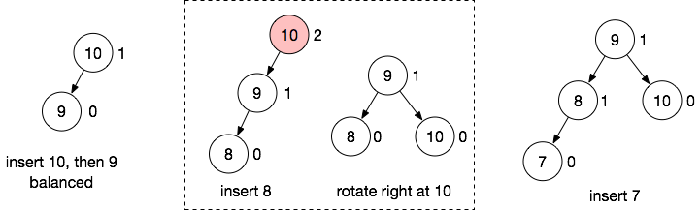
Example of insertion
Let’s insert the numbers 10, 9, 8, 7, 6 and 5.
Balance factor shown beside each node.

Slide 15
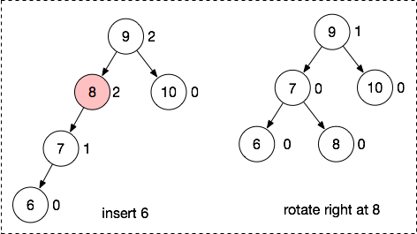
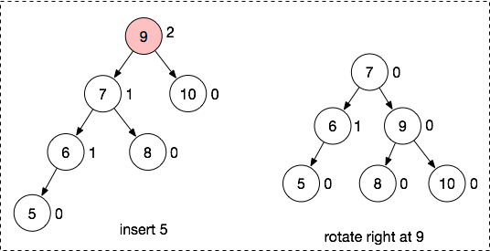
Example of insertion (cont.)
Let’s insert the numbers 10, 9, 8, 7, 6 and 5.
Start at 6, and walk up the ancestors until we find one to balance, in this case 8. After balancing 8, 9 becomes balanced.
No unbalanced node until 9, the root. Rotate right at the root.

Slide 16
Some notes on insertion
Inserting a node may increase the height of all of its ancestors.
This could create imbalance at any of its ancestors.
We need to visit each ancestor and consider if we need to rebalance.

Slide 17
AVL insert pseudocode
AVLInsert(tree, node) {
BSTInsert(node);
node = node->parent;
while(node != NULL) {
computeHeight(node);
balance(node);
node = node->parent;
}
}
Re-use BST insert algorithm.

Slide 18
AVL insert pseudocode
AVLInsert(tree, node) {
BSTInsert(node);
node = node->parent;
while(node != NULL) {
computeHeight(node);
balance(node);
node = node->parent;
}
}
Walk the node’s ancestors.
Update the height of each ancestor.
Try to balance each one.

Slide 19
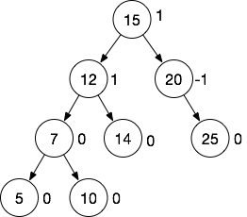
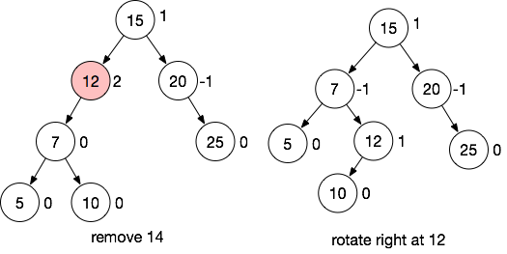
Example of removal
Remove 14, 5

Slide 20
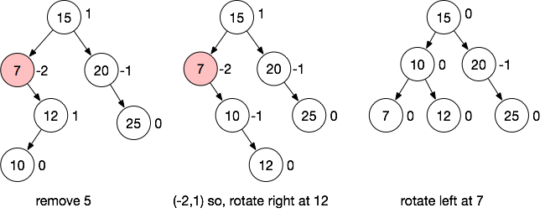
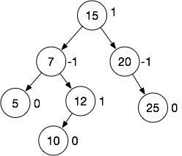
Example of removal (cont.)
Remove 5

Slide 21
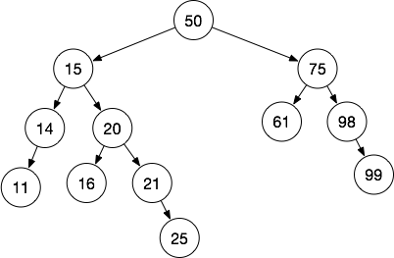
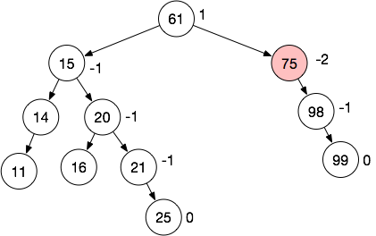
Example 2 of removal
What happens when we remove 50?

Slide 22
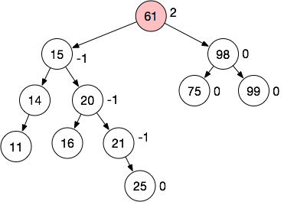
Example 2 of removal (cont.)
(-2,-1) pattern at 75 needs a left rotate.

Slide 23
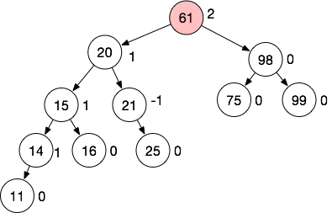
Example 2 of removal (cont.)
(2,-1) pattern needs a left rotate followed by right.
Left rotate 15

Slide 24
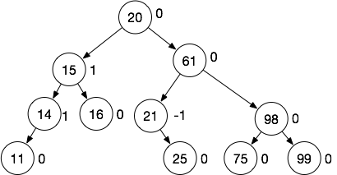
Example 2 of removal (cont.)
(2,-1) pattern needs a left rotate followed by right.
Right rotate 61

Slide 25
Example 2 of removal
Recap of what happens when we remove 50...
We move 61 to the root.
(-2,-1) rotate at 75
(2,-1) rotate at new root, 61. This moves 20 to the root.
After removal, we need to re-balance starting at 75, the original parent of the successor that’s used to replace 50.

Slide 26
AVL removal pseudocode
AVLRemove(tree, key) {
node = BSTRemove(tree,key);
while(node != NULL) {
computeHeight(node);
balance(node);
node = node->parent;
}
}
Re-use BST remove algorithm, but we modify it to return the parent of the removed node, or for Case 3, the parent of the successor.

Slide 27
Updates to BSTRemove
BTNode* BSTRemove(tree, key) {
node = root; // temporary variable, start at root of tree
parent = NULL; // need the parent node to update links
while (node not null) {
if (node->data == key) {
if (!Case1(tree,parent,node))
if(!Case2(tree,parent,node))
parent = Case3(tree,parent,node);
Free the node; return parent;
}
else if (key < node->data) {
parent = node;
node = node->left;
} else {
parent = node;
node = node->right;
}
}
}
Return the parent of the node removed.
For Case 3, return the original parent of the successor node of the node removed.

Slide 28
AVL tree in C++
AVL trees need most of the the functionality of a BST.
Idea: we want to re-use the BST implementation as much as possible.
An AVLTree is a BinarySearchTree
The is-a relationship implies public inheritance
But, we need to change some aspects of the BST implementation to make inheritance easier.

Slide 29
AVLTree is a BinarySearchTree
class AVLTree : public BinarySearchTree {
protected:
int balanceFactor(BTNode *node);
void balance(BTNode *node);
void rotateRight(BTNode *node);
void rotateLeft(BTNode *node);
public:
void insert(int data) override;
void remove(int data) override;
};
New functions to support critical AVLTree functionality: balancing and rotations.
Override insert and remove so we can perform balancing.

Slide 30
Changes to BinarySearchTree
We need class BTNode to include height and parent pointers.
We need to add support for updating and maintaining them into BinarySearchTree
We want to avoid re-implementing insert and remove inside AVLTree
Move the key functionality into private helper functions that can be used by the base class and derived class without overriding

Slide 31
BTNode changes
class BTNode {
public:
int data;
BTNode *left;
BTNode *right;
BTNode *parent;
int height;
void replace(BTNode *remove,
BTNode *node) {
if (left == remove)
setLeft(node);
else
setRight(node);
}
void setLeft(BTNode *l) {
left = l;
if (l) // set parent link
l->parent = this;
}
void setRight(BTNode *r) {
right = r;
if (r) // set parent link
r->parent = this;
}
int computeHeight();
BTNode(int d, BTNode *l = NULL, BTNode *r = NULL, BTNode *p = NULL);
};

Slide 32
The new BinarySearchTree::insert
void BinarySearchTree::insert(int data) {
BTNode *node = new BTNode(data);
insertHelper(node);
}
insertHelper has most of the insert logic, and now we can re-use that function in our AVLTree class without changing it.

Slide 33
The new BinarySearchTree::remove
void BinarySearchTree::remove(int data) {
BTNode *parent = removeHelper(data);
}
removeHelper has most of the remove logic, and now we can re-use that function in our AVLTree class without changing it.
The return value of removeHelper is the node where balancing should begin.

Slide 34
BinarySearchTree::removeHelper
BinarySearchTree::BTNode *BinarySearchTree::removeHelper(int data) {
BTNode *node = root;
while (node != NULL) {
if (data == node->data) {
// Found the node, remove it.
BTNode *parent = node->parent;
if (!Case1(node->parent, node))
if (!Case2(node->parent, node))
Case3(node->parent, node, parent);
// now we can delete the node
delete node;
return parent;
} else if (data < node->data) {
node = node->left;
} else {
node = node->right;
}
} // if parent==NULL, then no node to remove
return NULL; }
The return value of removeHelper is the node where balancing should begin.
Case 1&2: that’s the removed node’s parent
Case 3: the successor node’s parent

Slide 35
BinarySearchTree::Case3
void BinarySearchTree::Case3(BTNode *parent, BTNode *node, /*1*/ BTNode *&parent_succ) {
BTNode *succ = node->right;
while (succ->left != NULL) {
succ = succ->left; // go to left-most child
}
/* 2 */ parent_succ = succ->parent;
if (!Case1(parent_succ, succ))
Case2(parent_succ, succ);
// succ no longer in tree!
succ->setLeft(node->left);
succ->setRight(node->right);
if (parent == NULL)
setRoot(succ);
else
parent->replace(node, succ);
updateHeight(succ);
}
1. Third parameter is a reference to the successor node’s parent.
2. Update the reference once we find the successor.

Slide 36
AVLTree::insert
void AVLTree::insert(int data) {
BTNode *node = new BTNode(data);
insertHelper(node);
// balance the tree
BTNode *ancestor = node->parent;
while (ancestor != NULL) {
balance(ancestor);
ancestor = ancestor->parent;
}
}
Loop over ancestors of inserted node and balance them.

Slide 37
AVLTree::remove
void AVLTree::remove(int data) {
BTNode *ancestor = removeHelper(data);
while (ancestor != NULL) {
balance(ancestor);
ancestor = ancestor->parent;
}
}
Loop over ancestors of removed node and balance them.

Slide 38
Empirical analysis of AVL Tree
Insert 1000 mostly sorted items into a BST or an AVLTree and search before inserting them.
Compare the number of comparisons done during search on the BST and AVL tree.
Result: you should observe many fewer comparisons on the AVLTree.

Slide 39
Summary
Balancing a tree requires left rotations and right rotations.
The balance factor patterns (2,1), (2,-1), (-2,-1), and (-2,1) tell us what action to take.
On insertion, try to balance all ancestors of the inserted node.
On removal, balance the ancestors of the removed node, or for Case 3, balance the former ancestors of the node’s successor.
An AVLTree is a BinarySearchTree; we can use public inheritance.
But some refactoring of our BinarySearchTree is needed so that we can avoid replicating code in the base and derived classes.

Slide 40
References
1. ZyBook on Data Structures, chapters 18.1-18.4

